Slide 1
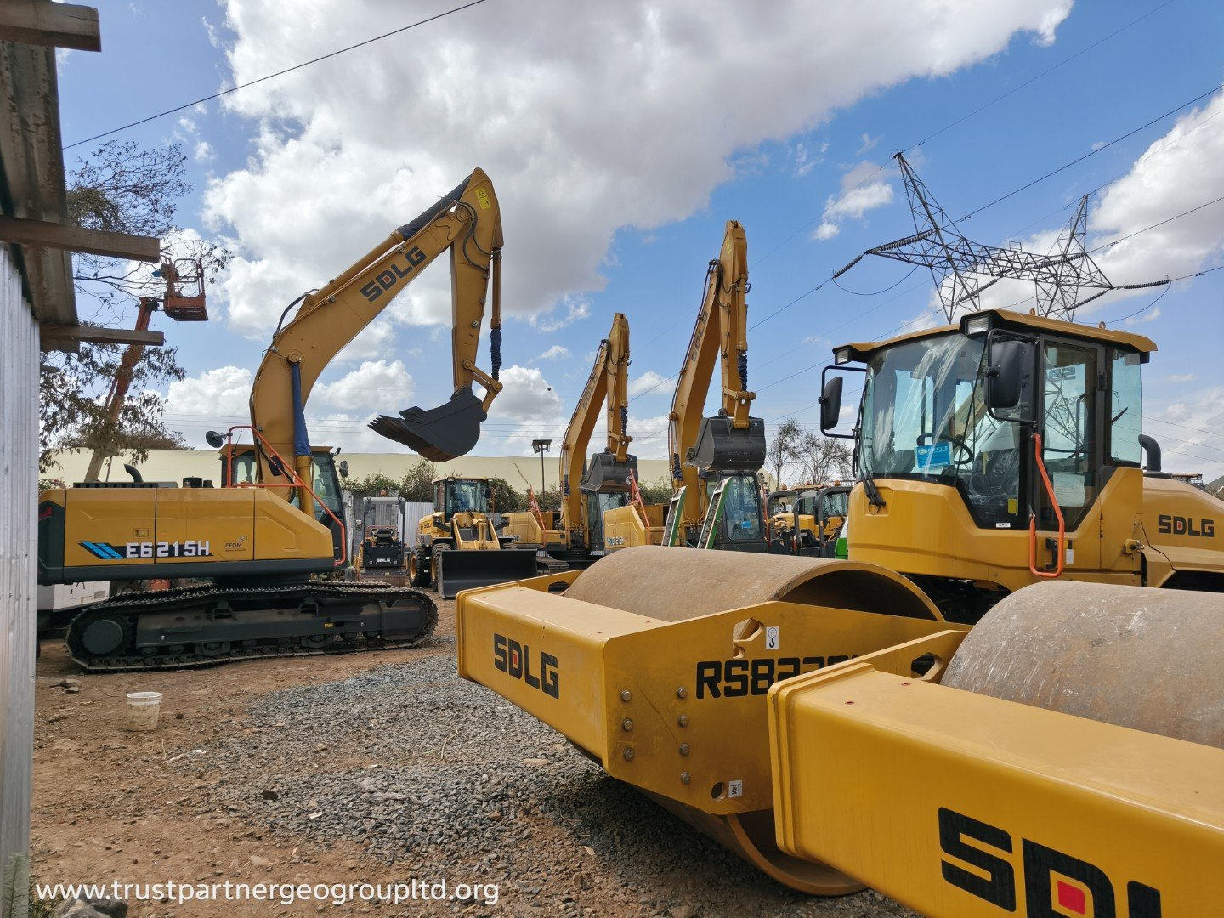


2026 PRODUCT RANGE · KENYA
HEAVY EQUIPMENT
FOR KENYA.
The complete SDLG range, backed by local sales, hire, parts and contracting support.
TRUST PARTNERS GEO-GROUP LTD · AUTHORIZED SDLG DEALER
01 / 14

Slide 2
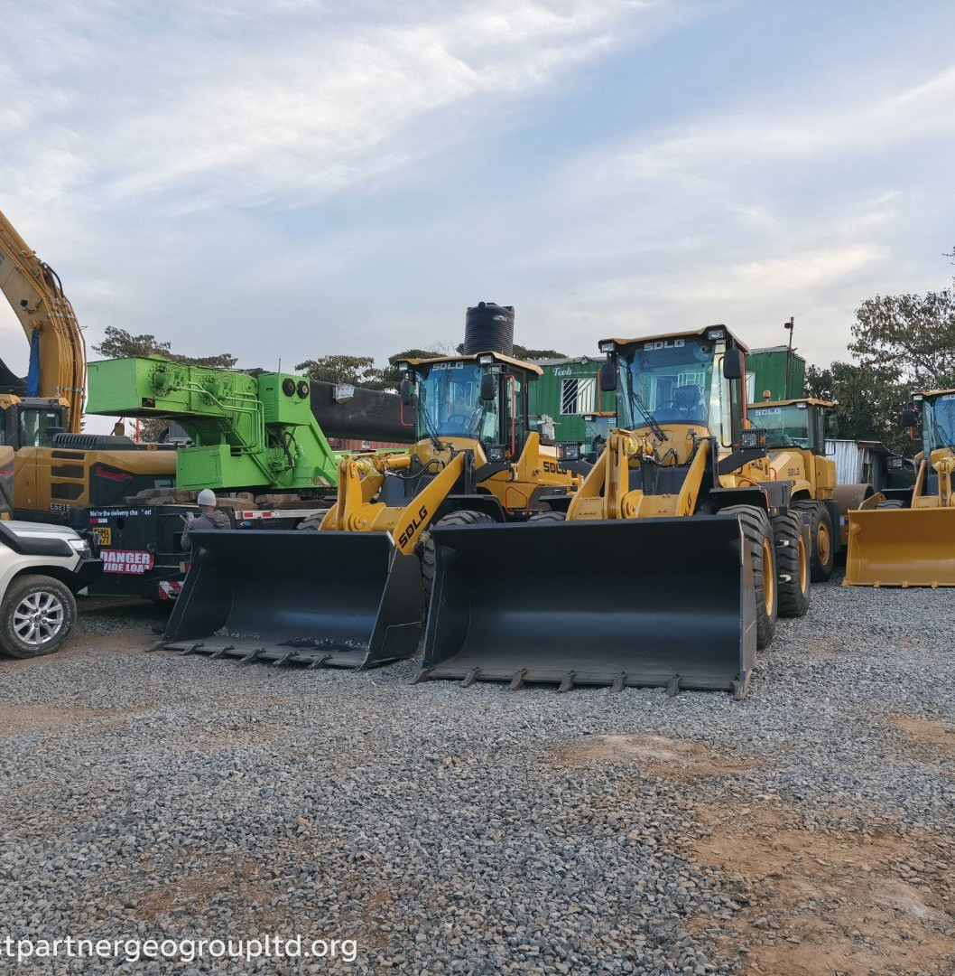
01 / THE LOCAL PARTNER
KENYA’S EARTHWORKS &
EQUIPMENT PARTNER
For over 15 years, Trust Partners Geo-Group has delivered excavation, civil engineering and heavy equipment solutions across Kenya. As an authorized SDLG dealer, the team combines machine supply with daily, real-site operating experience.
NCA-certified contractor · Genuine parts · Certified operators · Nationwide logistics from Ruai, Nairobi
SDLG machines at our Ruai yard, Nairobi
15+
9
24 hr
SALES · HIRE · CONTRACTING
One partner from site preparation to handover.
YEARS IN KENYA
SERVICE LINES
RESPONSE TIME
02 / 14

Slide 3
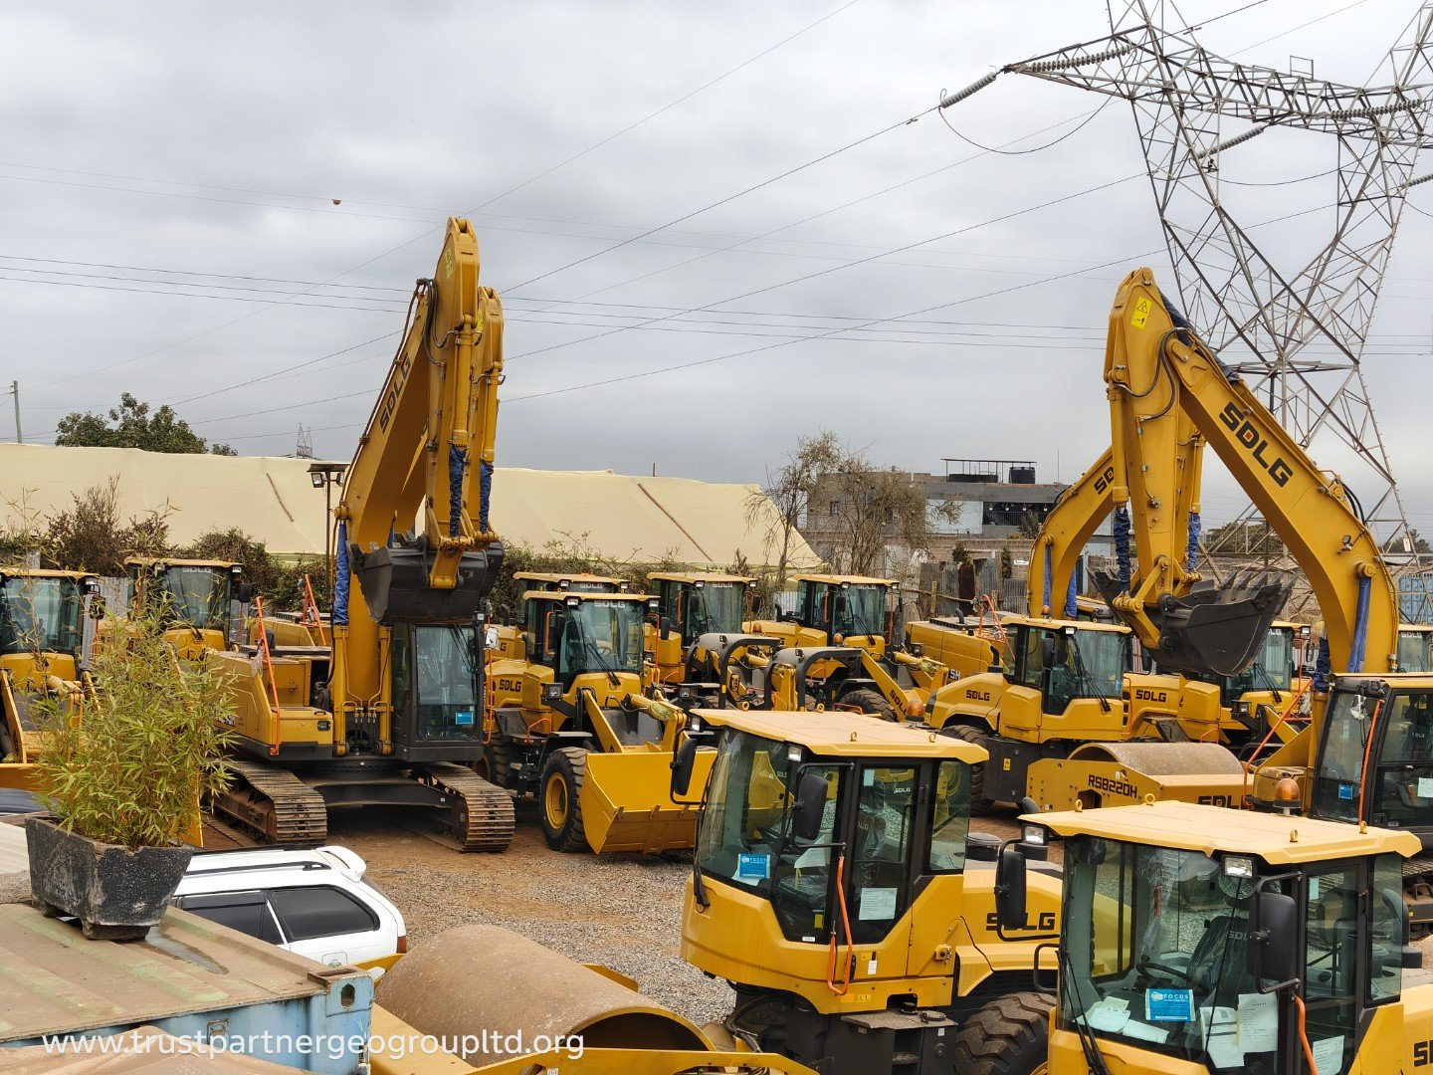
02 / THE COMPLETE RANGE
40+
ONE PARTNER.
EVERY MACHINE.
MODELS FEATURED
01 Crawler excavators
02 Wheel loaders
03 Electric & hybrid
04 Motor graders
05 Dozers & backhoes
06 Compaction
07 Compact track loaders
08 Attachments
2.6–95 t
1–10 t
≈420 kW
EXCAVATOR WEIGHTS
LOADER PAYLOADS
ENGINE POWER TO
Source: 2026 SDLG Equipment Catalogue · Specifications indicative
03 / 14

Slide 4
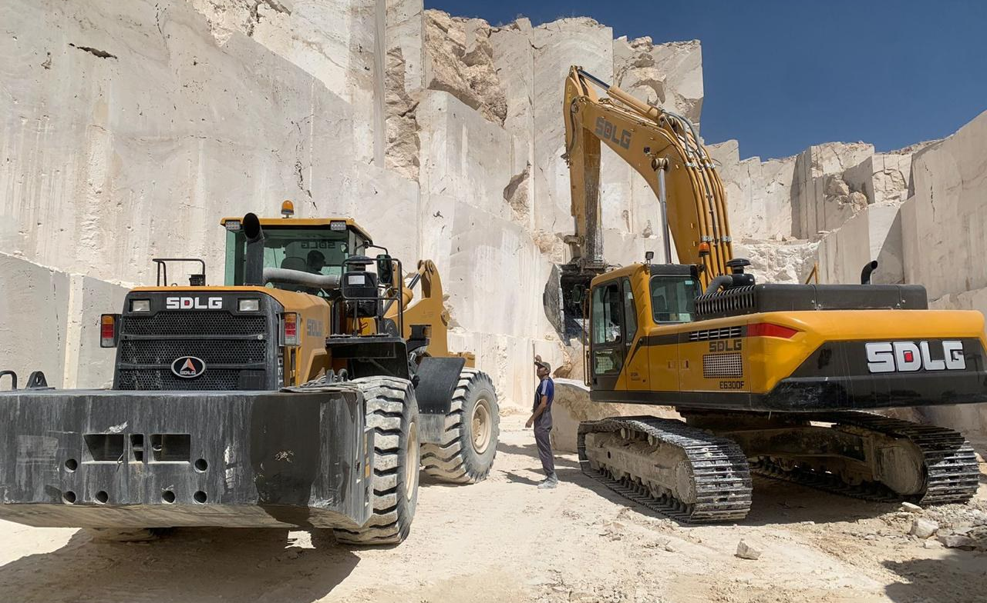
03 / CRAWLER EXCAVATORS
COMPACT TO MINING.
2.6–95 t
OPERATING-WEIGHT RANGE
Zero-tail compact machines, mid-range workhorses, large quarry excavators and 95-tonne mining flagships — plus long-reach and amphibious specials.
Large SDLG excavators in quarry service
CLASS | REPRESENTATIVE MODELS | WEIGHT | BUCKET | TYPICAL APPLICATIONS
Compact | ER626H – ER636H | 2.6–3.6 t | 0.05–0.12 m³ | Utilities, farms, tight sites
Mid-range | E6135H – E6255H | 13.5–25.5 t | 0.6–1.2 m³ | Roads, drainage, earthworks
Large | E6305H – E6505H | 30.5–50 t | 1.6–2.5 m³ | Quarries, mass excavation
Mining | E6650H / E6950H | 65–95 t | 3.6–5.6 m³ | Open-pit and heavy mining
Source: 2026 catalogue, pp. 7–11 · Specifications vary by configuration
04 / 14

Slide 5
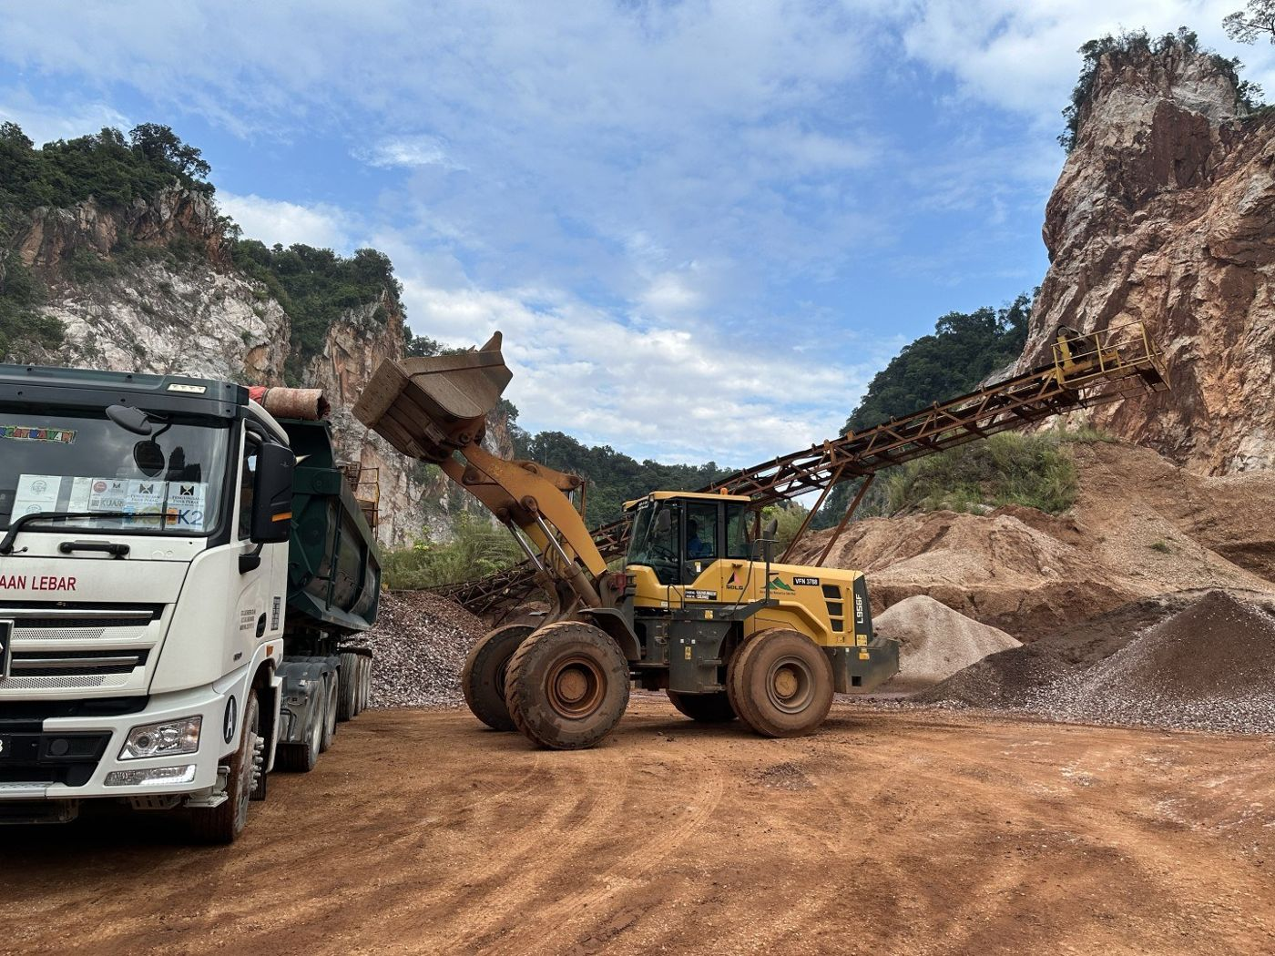
04 / WHEEL LOADERS
BUILT TO LOAD.
BUILT TO LAST.
From compact farm loaders to a 10-tonne flagship, with buckets from 0.6 to 5.4 m³.
L90xH SERIES · 1.0–1.5 t
Farms, yards and tight sites
L918H / L936H / L938H · 1.8–3.0 t
Batching, estates and aggregates
L955H / L956H / L958H · 5.0–5.5 t
Quarries, roads and load-and-carry
L968H / L975H / L9100H · 6.5–10 t
High-production quarry and mining work
1–10 t
RATED PAYLOAD RANGE
Quick couplers · pallet forks · grapples · 4-in-1 buckets · bale grabs
SDLG loader feeding trucks in quarry service
05 / 14

Slide 6
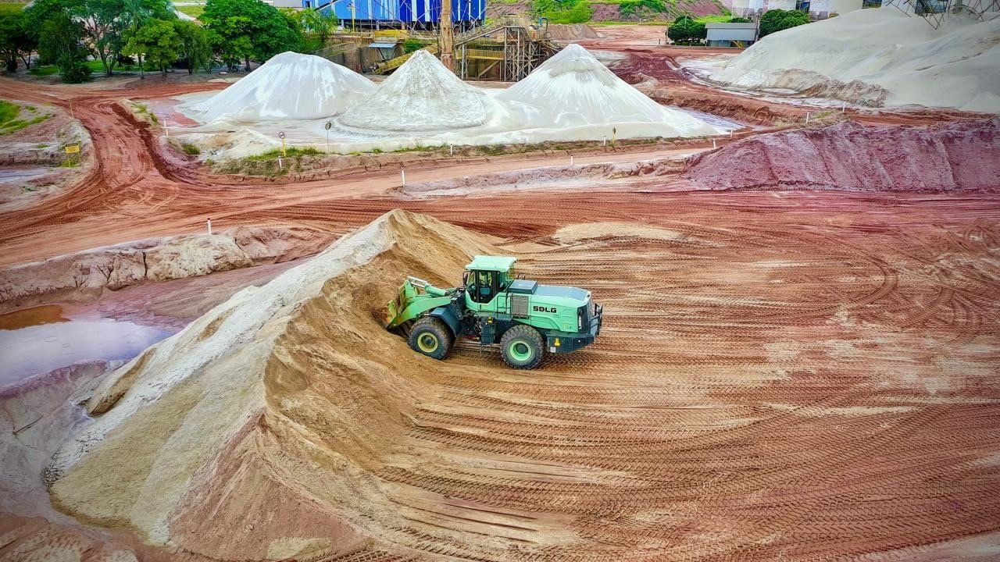
05 / ELECTRIC & HYBRID
ZERO-EMISSION
MACHINES
UP TO 60% LOWER ENERGY COST
Battery-electric digging and loading for urban sites, indoor yards, low-noise work, quarries and ports.
E6225HEV · 22.5 t electric excavator
E660HEV · 60 t electric excavator
L938HEV – L980HEV · 3–8 t electric loaders
ZERO TAILPIPE EMISSIONS
Lower noise · Fewer engine service parts
Factory-order machines · Typical lead time 8–12 weeks · Charging and local support available
06 / 14

Slide 7
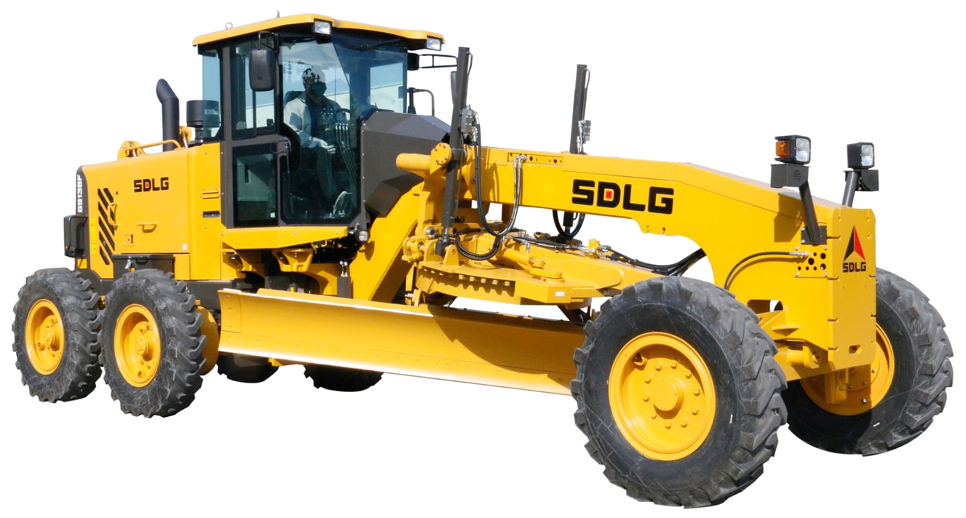
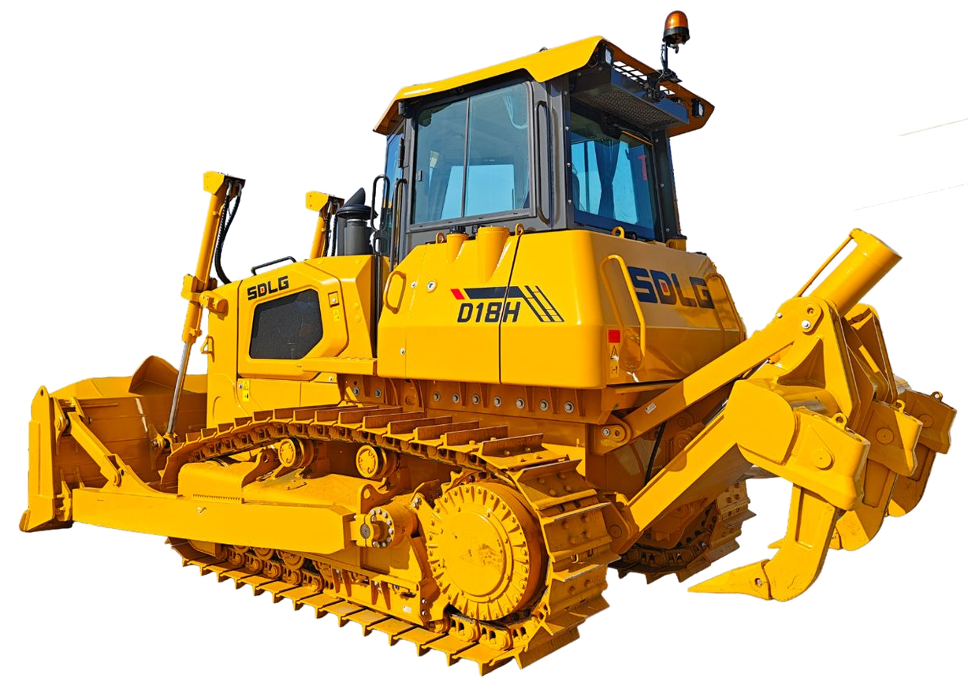
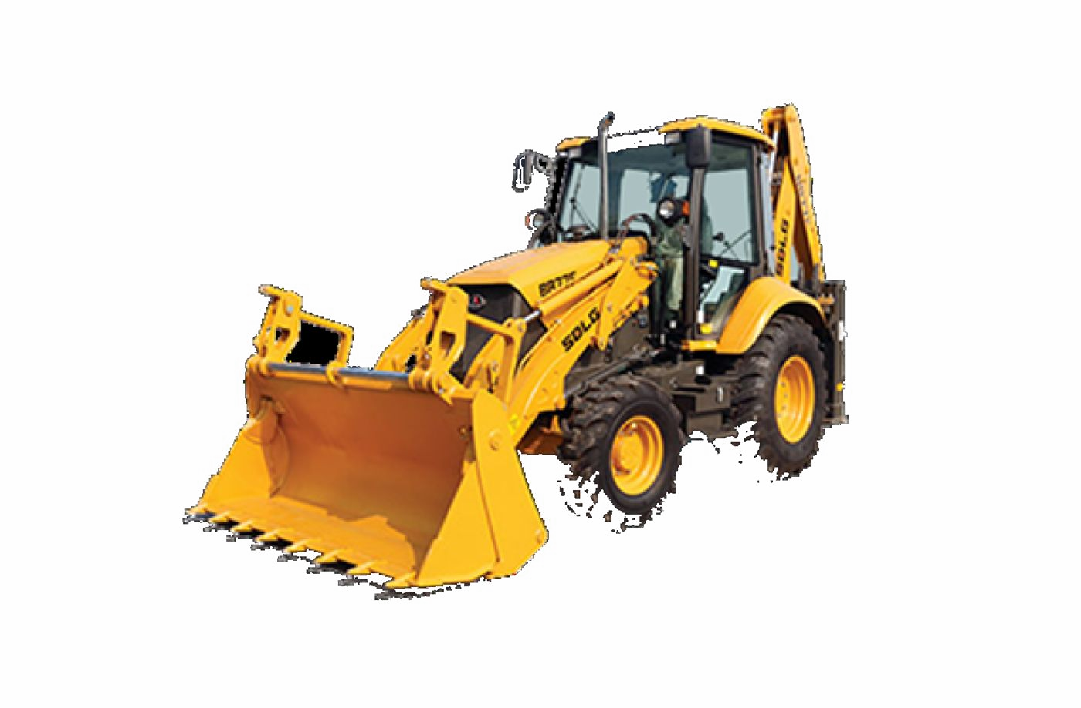
06 / ROAD MACHINERY
GRADE. PUSH. DIG.
A road-building fleet for county roads, highways, mining roads, utilities and land clearing.
MOTOR GRADERS
G9138H · G9190H · G9300H
≈13.5–22 t class · Blade lengths 3.66–4.27 m · Rear ripper options
D18H CRAWLER DOZER
17.5 t · 203 kW · 8.3 m³ blade
Standard rear ripper · Land clearing, bulk push and ripping
B877F BACKHOE LOADER
8.4 t · ≈92 kW · 1.0 m³ loader bucket
≈4.3 m digging depth · Utilities, trenching and municipal work
Source: 2026 catalogue, pp. 22–23 · Specifications indicative
07 / 14

Slide 8
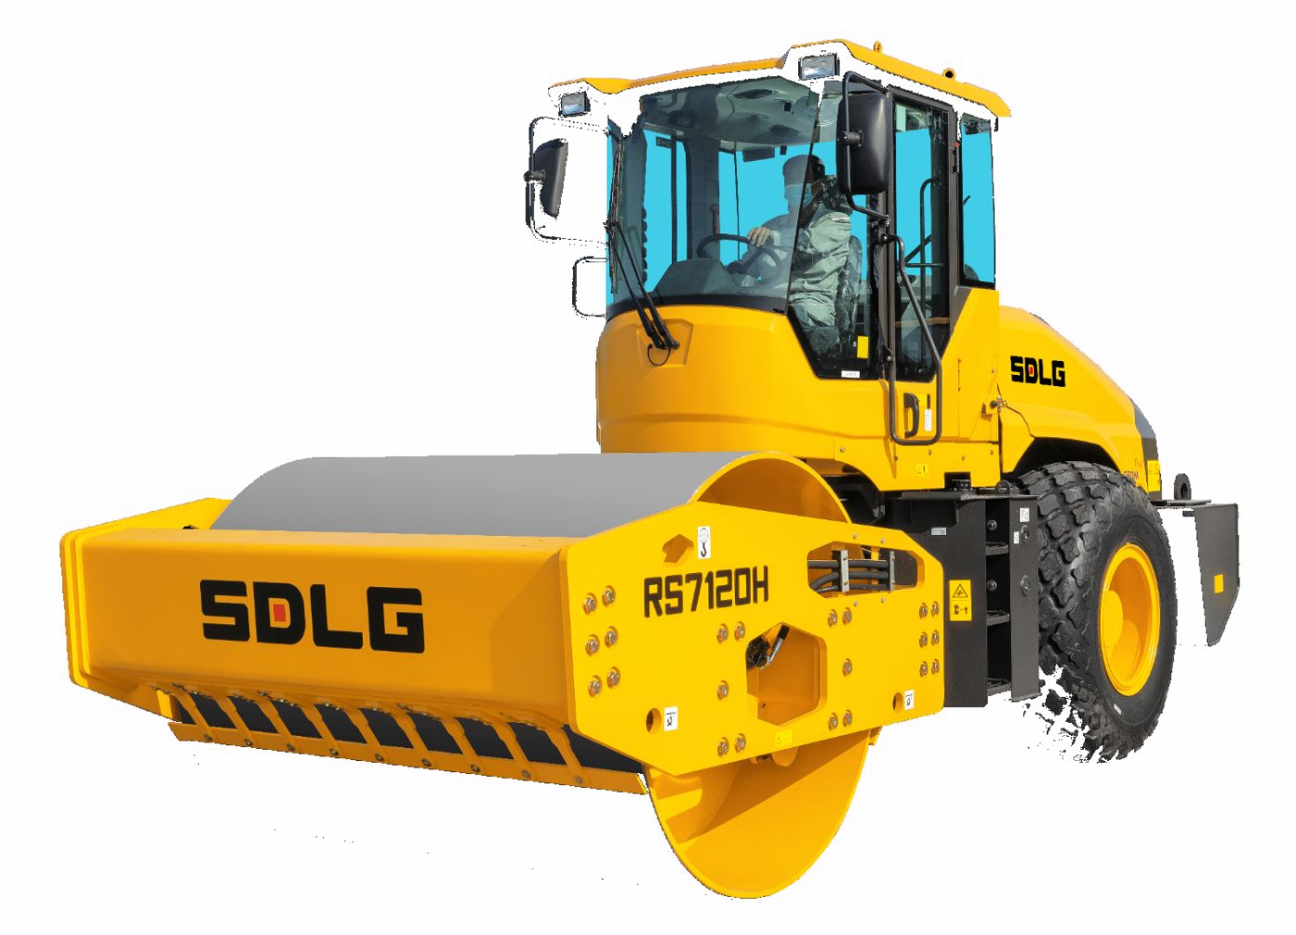
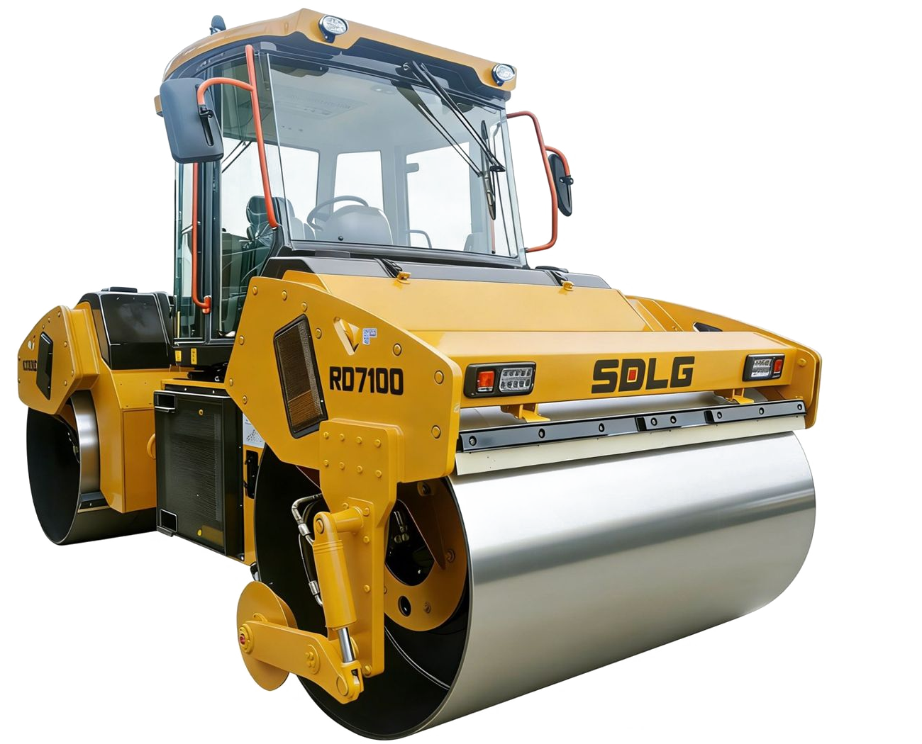
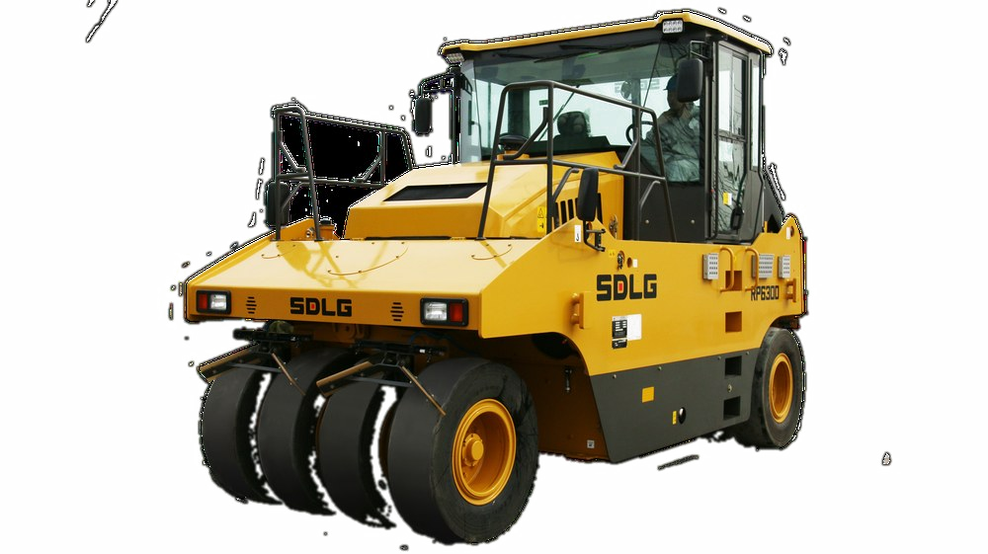
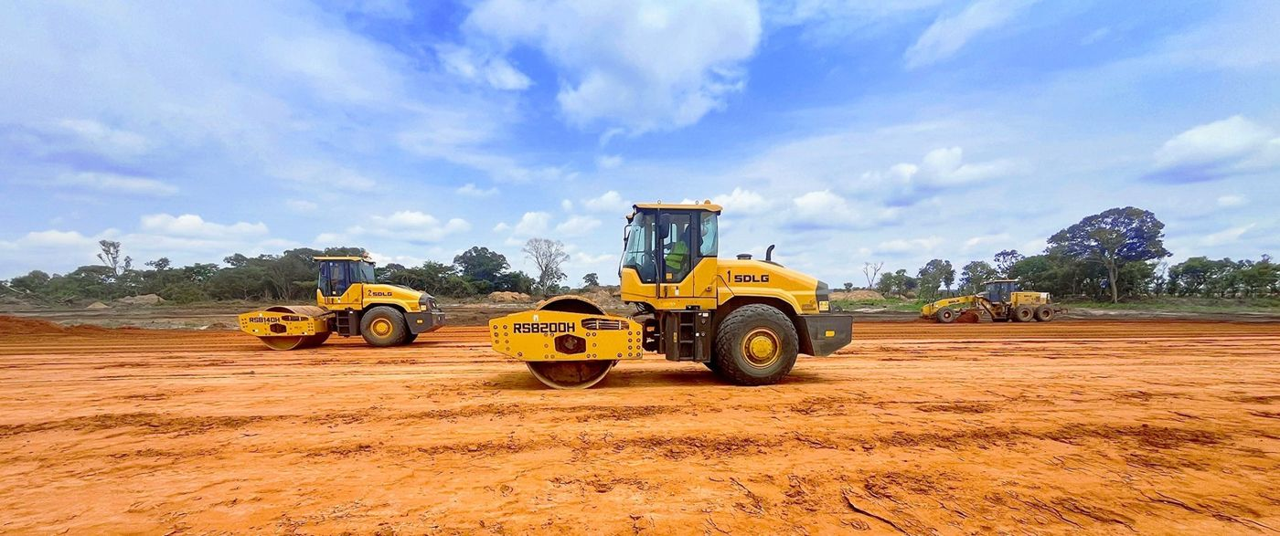
07 / COMPACTION
THE FULL PAVING TRAIN.
Single-drum soil compactors, tandem asphalt rollers and pneumatic tyre rollers from 3 to 30 tonnes.
10–26 t · SOIL COMPACTORS
RS7100H – RS7260H · 2,130 mm drums · Dual amplitude
3–12 t · TANDEM
RD730 / RD7100 / RD7120 · Footpaths to highways
30 t · PNEUMATIC
RP6300 · Sealing, chipseal and base kneading
Source: 2026 catalogue, pp. 25–26 · Padfoot shells available for cohesive soils
08 / 14

Slide 9

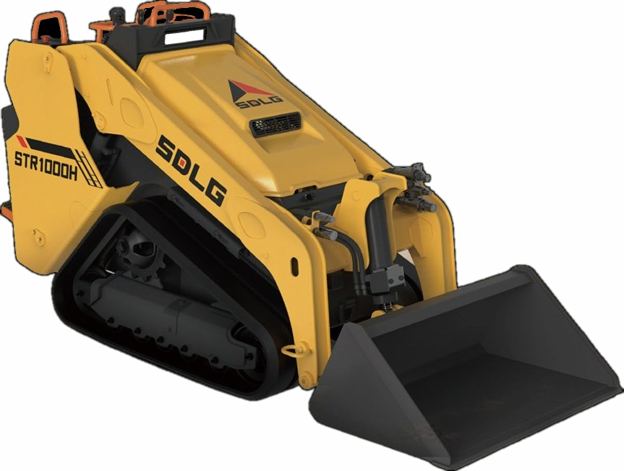
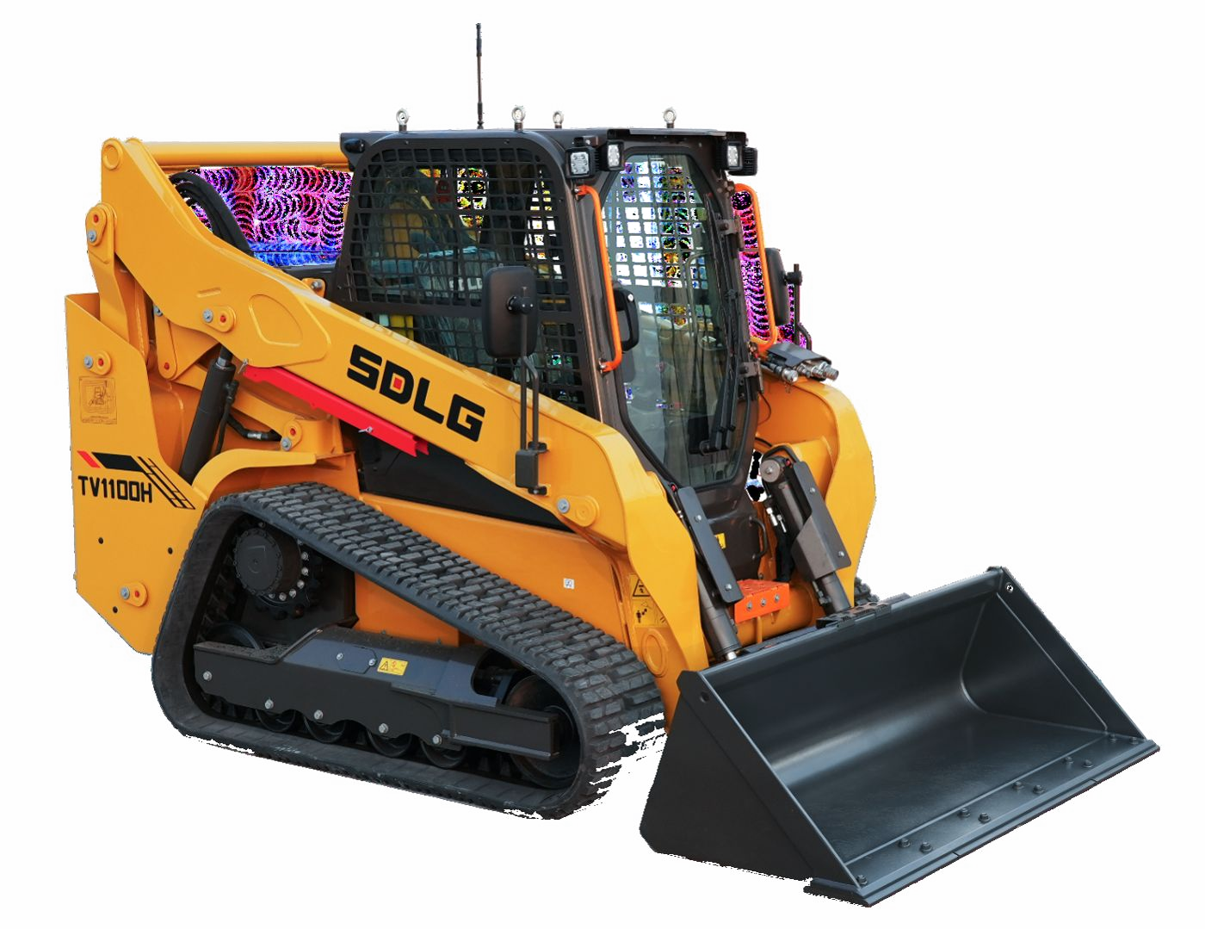
08 / COMPACT TRACK LOADERS
ONE CARRIER.
DOZENS OF JOBS.
STR1000H
≈1,000 kg rated capacity · Rubber tracks
TV1100H
≈1,100 kg rated capacity · Vertical lift
STANDARD QUICK-ATTACH PLATE
SMALL SIZE. BIG OUTPUT.
Machines and attachments for sites, farms and landscaping.
Augers · trenchers · sweepers · pallet forks · 4-in-1 buckets · brooms
09 / 14

Slide 10
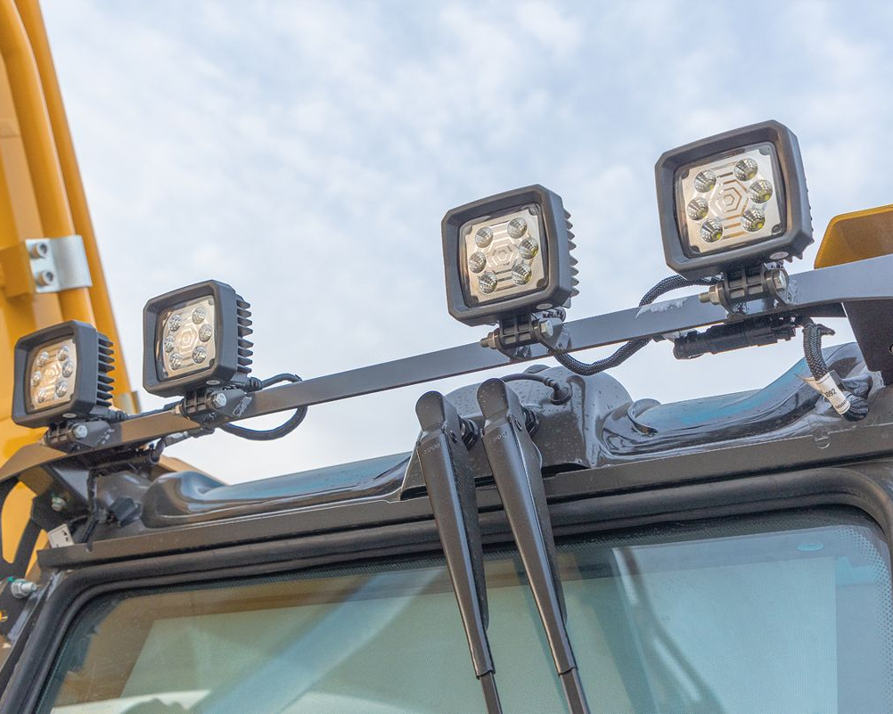
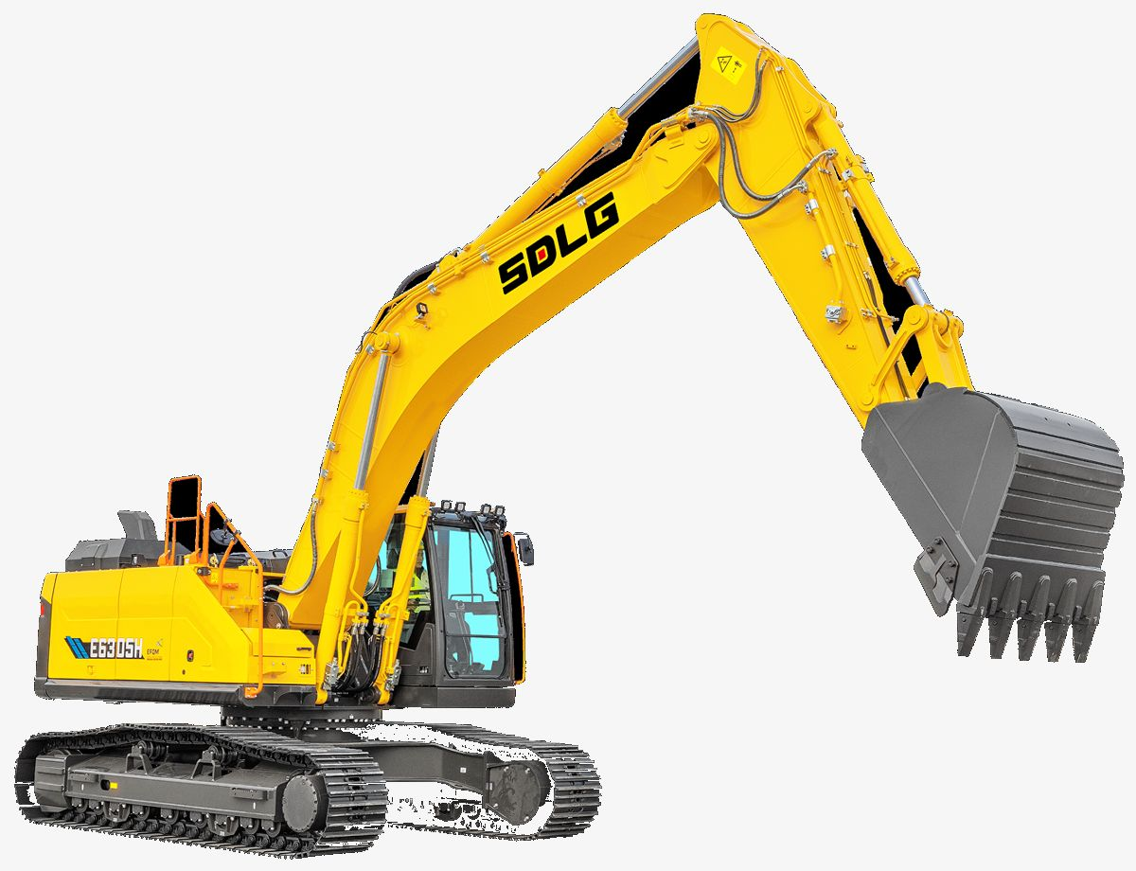
09 / TECHNOLOGY & OWNERSHIP
ENGINEERED FOR
LOWER COST
PER HOUR.
PROVEN ENGINES
Globally supported platforms
LOAD-SENSING HYDRAULICS
Power on demand, fuel saved
ROPS/FOPS CABS
Visibility and operator comfort
SMART DISPLAYS
Fuel, diagnostics and alerts
LED WORK LIGHTS
Night-shift ready
HEAVY-DUTY STRUCTURES
Protected piping, strong booms
Fuel efficient · Easy to service · Strong resale
10 / 14

Slide 11
10 / SERVICES, PARTS & SUPPORT
MORE THAN A SALE.
Sales, hire and contracting support from one Ruai, Nairobi base — with nationwide mobilization.
01 NEW SDLG MACHINE SALES
Stock machines, factory orders and financing options
02 HEAVY EQUIPMENT HIRE
Late-model machines with certified operators
03 EXCAVATION & CIVIL WORKS
Earthworks, roads, dams, demolition and site preparation
04 GENUINE PARTS
Local stock backed by the SDLG TOP SERVICE network
05 LOW-LOADER TRANSPORT
Delivery to sites across Kenya and the region
06 24/7 EMERGENCY DISPATCH
Excavator, grader and breaker support
SALES · HIRE · PARTS · CONTRACTING
11 / 14

Slide 12
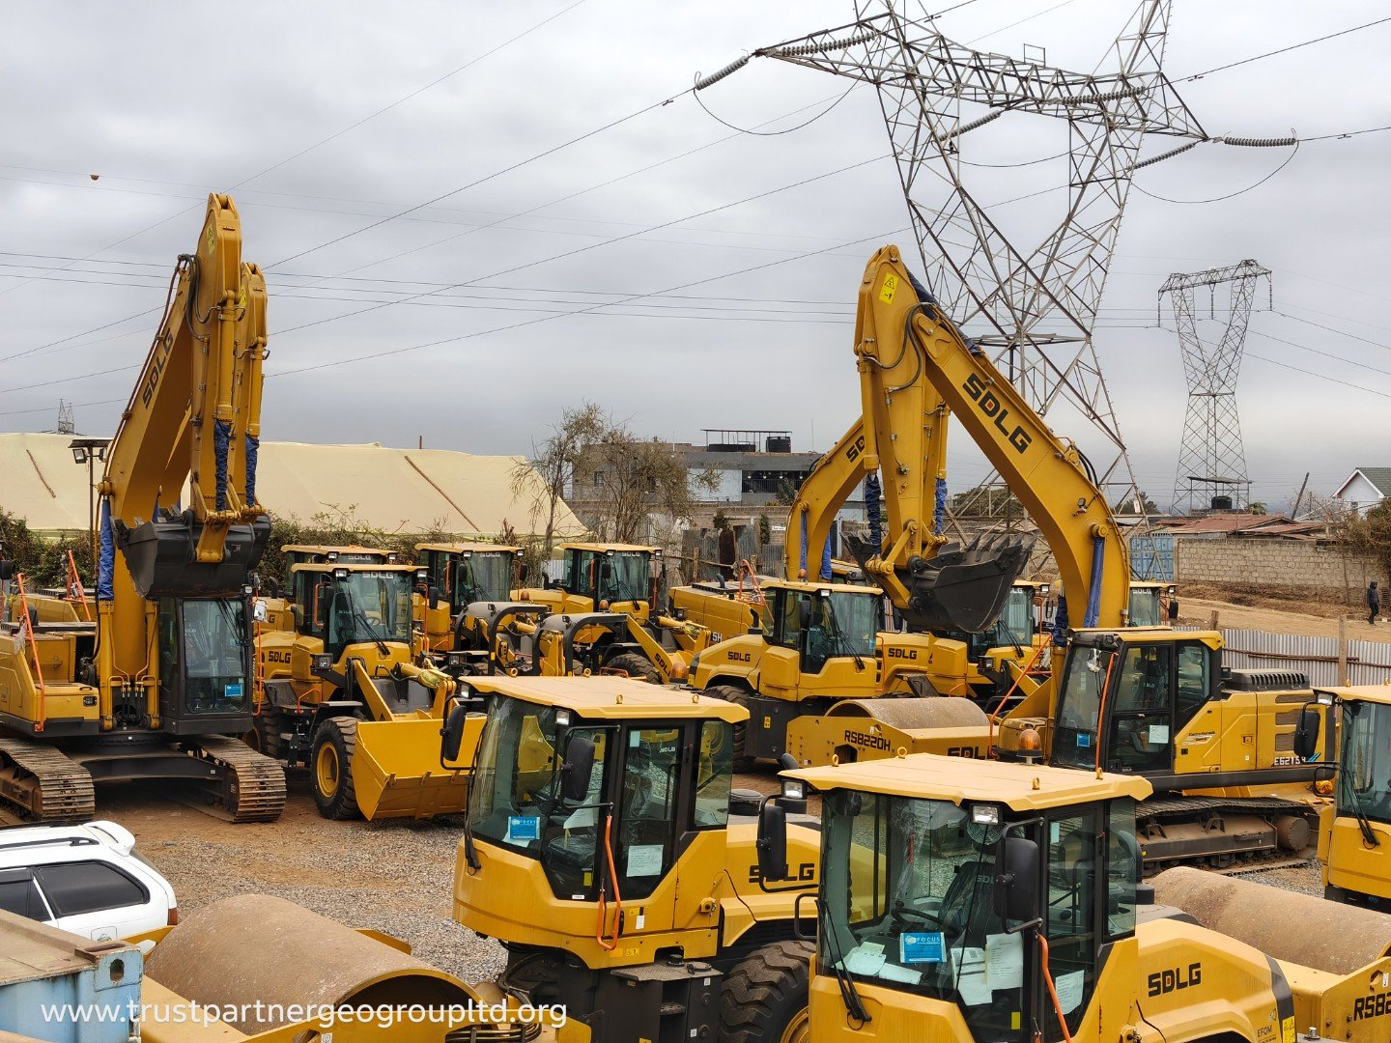
11 / WARRANTY & DELIVERY
BUY WITH CONFIDENCE.
STANDARD FACTORY WARRANTY
1 YEAR / 2,000 HOURS
Honoured in Kenya · Extendable to 2 years
STOCK MACHINES
About 2 weeks
FACTORY ORDERS
8–12 weeks
THE AUTHORIZED DEALER ADVANTAGE
Factory warranty · Genuine local parts · Operator training
Trade-in and fleet support · Financing and lease-to-own options
Machines inspected and prepared for delivery at the Ruai yard.
12 / 14

Slide 13
12 / HOW TO ORDER
FROM QUOTE TO SITE.
Stock: about 2 weeks
Factory orders: 8–12 weeks
01
02
03
04
05
06
CHOOSE YOUR MACHINE
Shortlist by tonnage, payload and application.
GET A WRITTEN QUOTE
Price, warranty, lead time and delivery confirmed.
AGREE TERMS
Payment, financing and trade-in options documented.
INSPECTION & PREPARATION
Fluids, filters, grease points and safety verified.
DELIVERY & HANDOVER
Low-loader delivery, commissioning and familiarization.
LIFETIME SUPPORT
Parts, service and local warranty support.
WRITTEN QUOTATION WITHIN 24 HOURS
Share the machine type, site location and required duration.
Long-term hire and lease-to-own available.
CALL / WHATSAPP +254 718 686 967
13 / 14

Slide 14
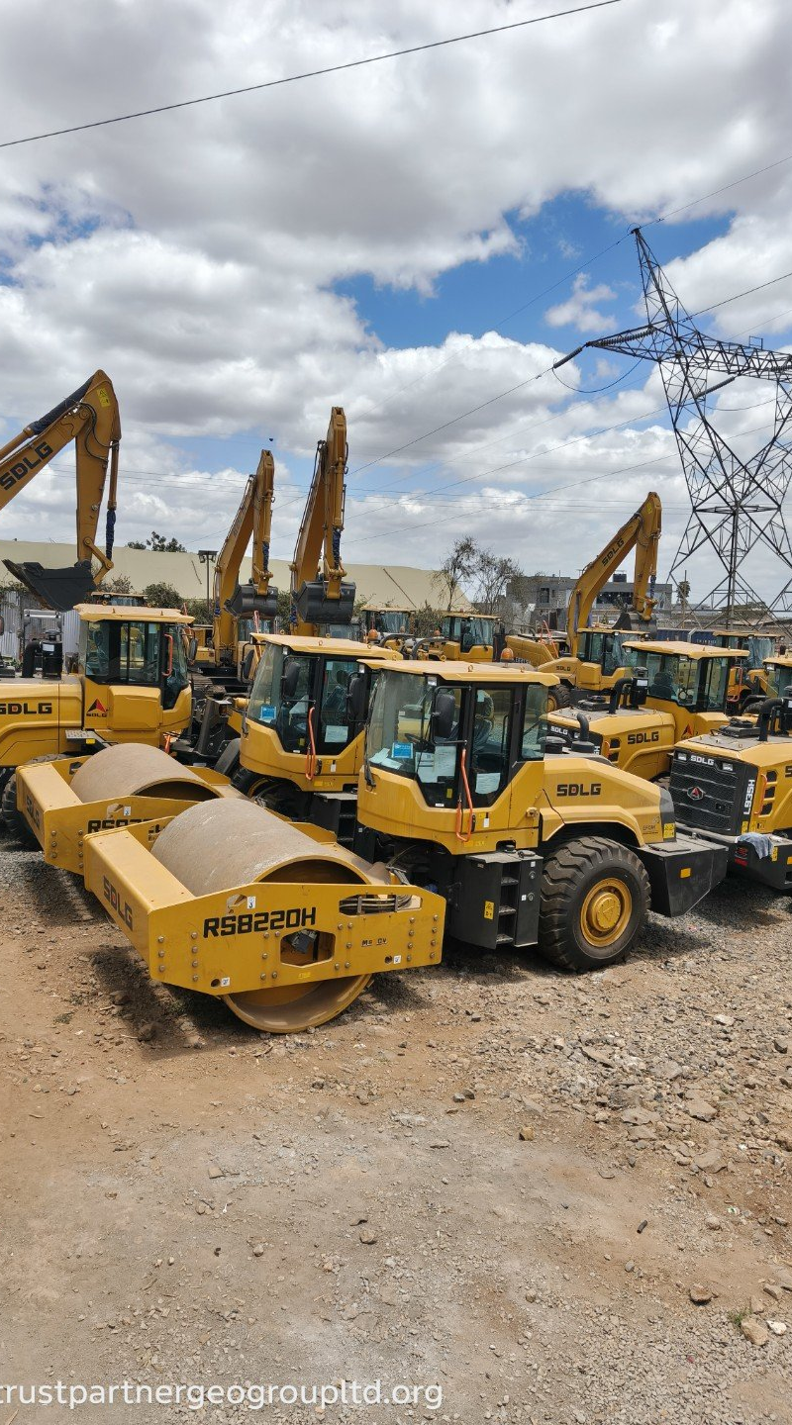
LET’S PUT A MACHINE
ON YOUR SITE.
CALL / WHATSAPP +254 718 686 967
EMAIL info@trustpartnergeogroupltd.org
WEB www.trustpartnergeogroupltd.org
VISIT Ruai, Mawe Mbili — Off Ruai Bypass, Nairobi
AUTHORIZED SDLG DEALER · KENYA
Specifications are indicative and subject to change. Images may show optional equipment.
14 / 14

